Slide 1
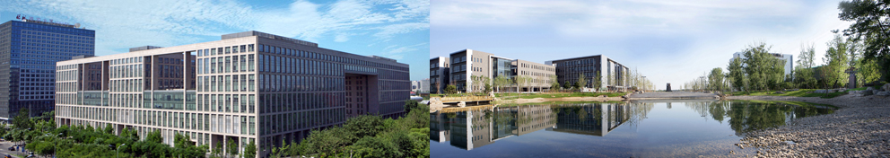

Graph Search in the Big Data Era
马帅 计算机学院

Slide 2

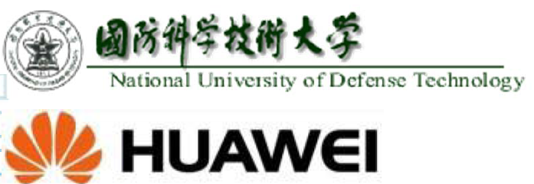
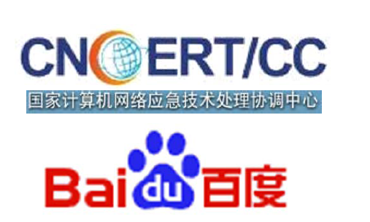

973 Grant on Big Data at Beihang
网络信息空间大数据计算的基础研究(2014-2018)
Chief Scientist: Prof. Jinpeng Huai.
8 institutes involved
Focus on “computing theory and practice on Big Data”

Slide 3
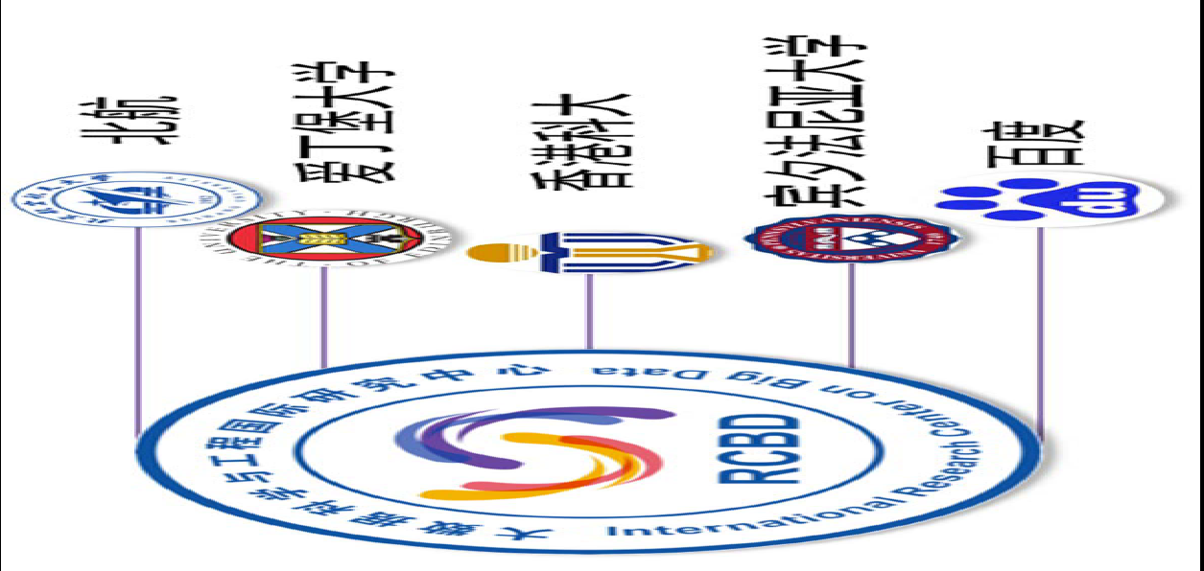
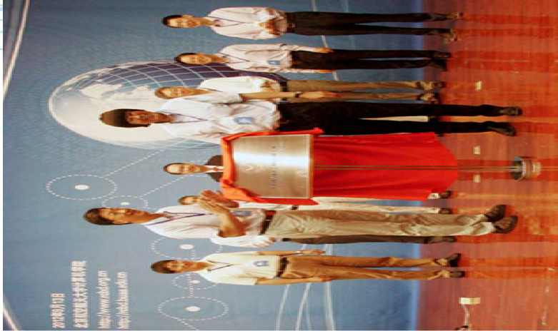
RCBD at Beihang
International Research Centre on Big Data (RCBD)
Founded in September, 2012.
Led by Prof. Wenfei Fan (ACM Fellow, Fellow of the Royal Society of Edinburgh, Scotland) .
Research Topics
Big Data Analysis: Theory and Applications
Data Quality: The Other Side of Big Data
Querying Big Data beyond MapReduce
Querying Big Social Data

Slide 4
Big Data is a Big Deal

Slide 5
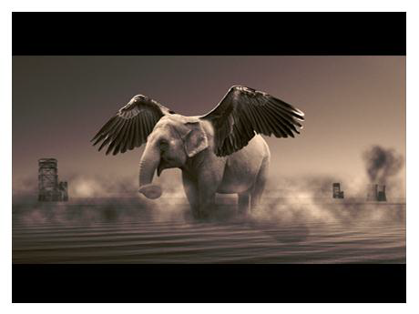

What is Big Data?
Big Data refers to datasets that grow so large that it is difficult to capture, store, manage, share, analyze and visualize with those traditional (database) software tools
Wikipedia
“Big data” becomes a buzz word, and the focus of both industrial and academic communities!

Slide 6
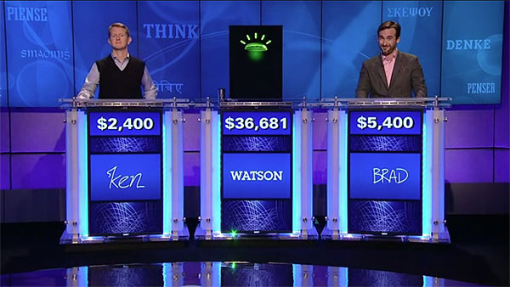
Human vs. Computer + Big Data
IBM “Watson” system challenges humans at Jeopardy!
In 2011, Watson beat former winners Brad Rutter and Ken Jennings. Watson received the first prize of $1 million.
Compared with “Deep Blue”, ““Watson” is equipped with Big Data!

Slide 7
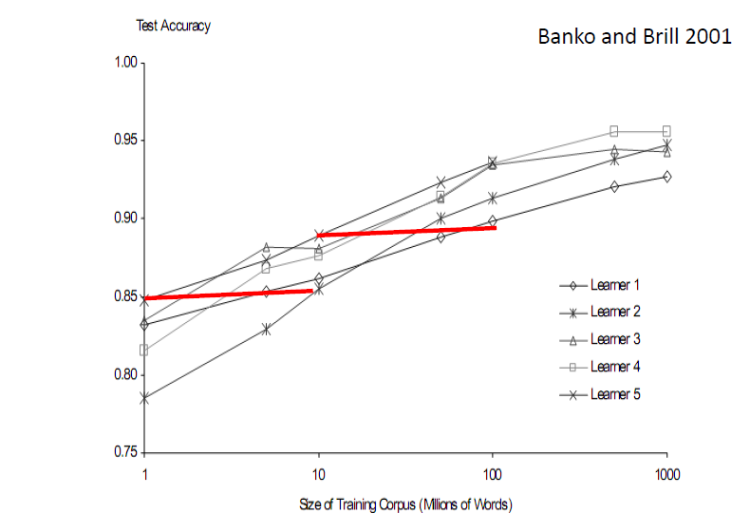
More Data Beats Better Algorithms

Slide 8
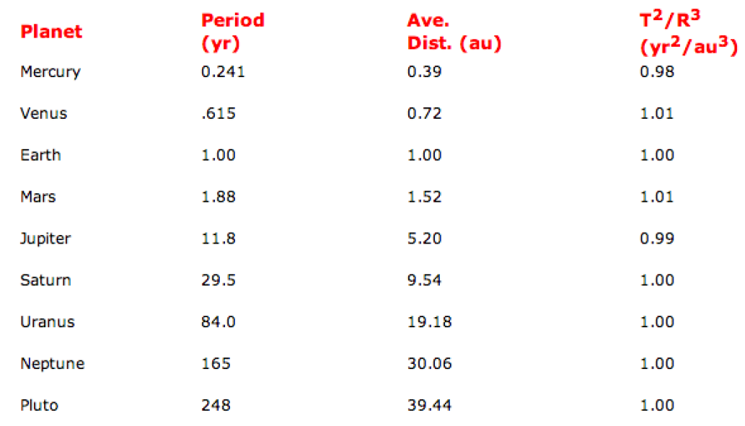
Kepler's Third Law of Planetary Motion
The square of the orbital period of a planet is directly proportional to the cube of the semi-major axis of its orbit

Slide 9
Challenges and Opportunities with Big Data
- A community white paper developed by leading researchers across US
Divyakant Agrawal, UC Santa Barbara
Philip Bernstein, Microsoft
Elisa Bertino, Purdue Univ.
Susan Davidson, Univ. of Pennsylvania
Umeshwar Dayal, HP
Michael Franklin, UC Berkeley
Johannes Gehrke, Cornell Univ.
Laura Haas, IBM
Alon Halevy, Google
Jiawei Han, UIUC
Alexandros Labrinidis, Univ. of Pittsburgh
Sam Madden, MIT
Yannis Papakonstantinou, UC San Diego
Jignesh M. Patel, Univ. of Wisconsin
Raghu Ramakrishnan, Yahoo!
Kenneth Ross, Columbia Univ.
Cyrus Shahabi, Univ. of Southern California
Dan Suciu, Univ. of Washington
Shiv Vaithyanathan, IBM
Jennifer Widom, Stanford Univ
A result of conversation lasted about 3 months (Nov. 2011 ~ Feb. 2012)

Slide 10
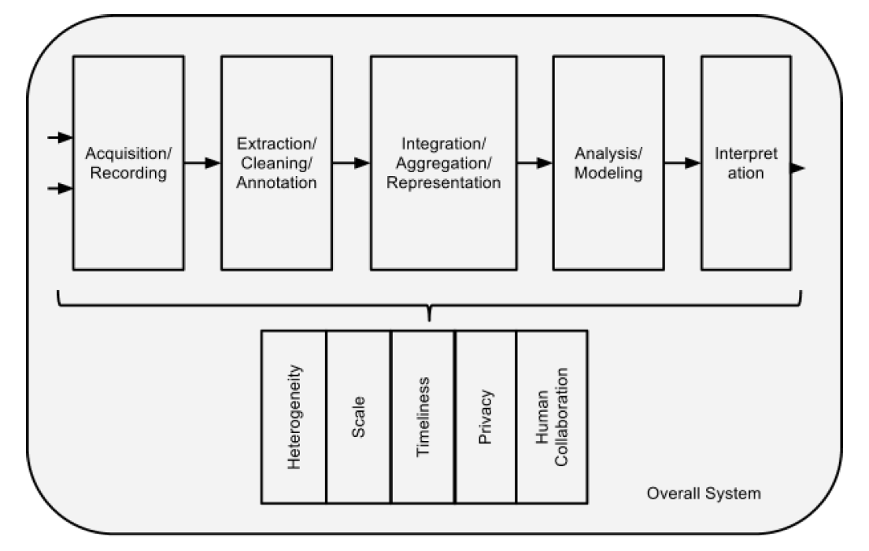
Challenges

Slide 11
Gartner’s Most Recent Report

Slide 12
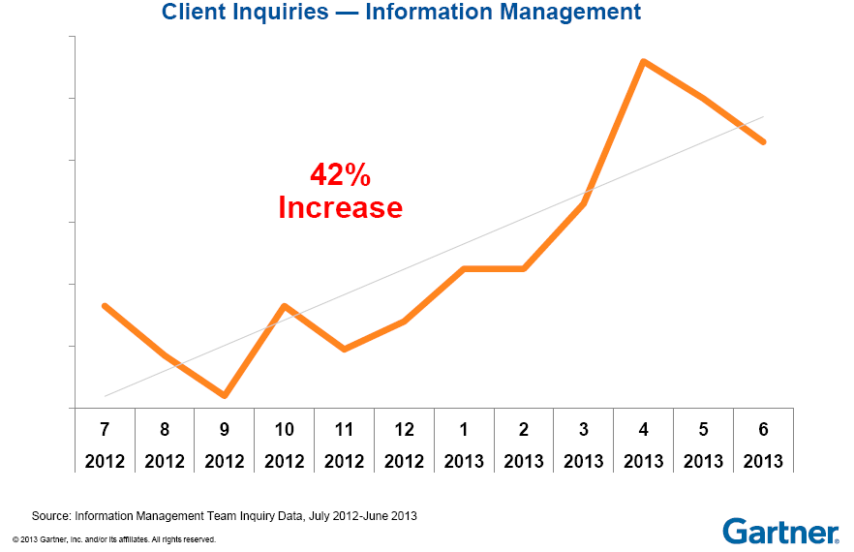
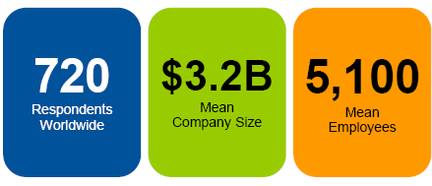
Industries’ Interests

Slide 13
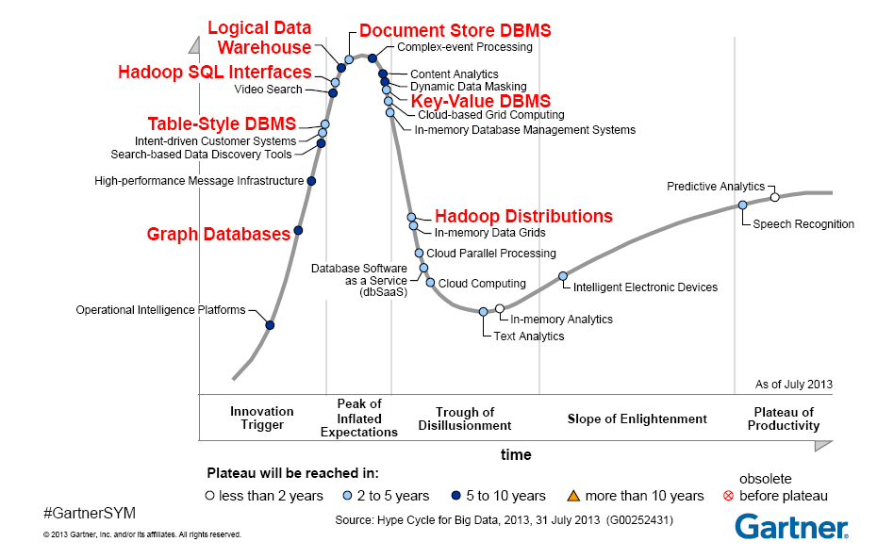
Big Data Techniques

Slide 14
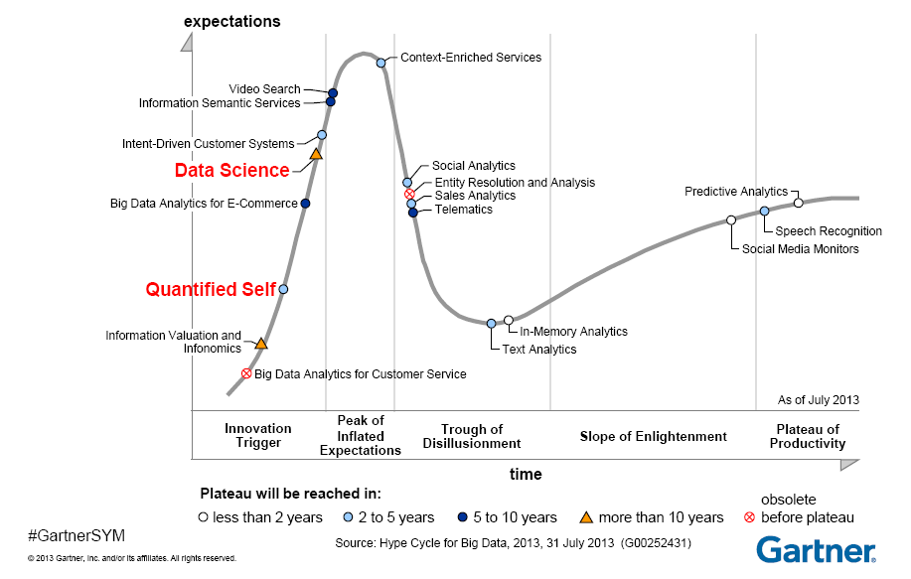
Big Data Techniques
Notes:
一个将个人日常生活中用输入、状态和表现这样的参数，将科学技术引入日常生活中的技术革命

Slide 15
Social Networks are Big Graphs

Slide 16
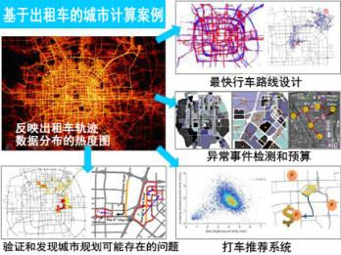
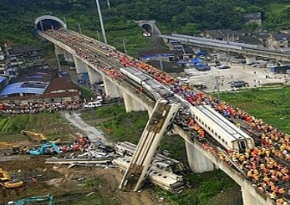
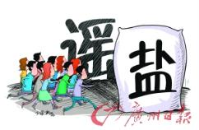
Social Networks are the New Media
金庸“被逝世”
Social networks are becoming an important way to get information in everyday life！

Slide 17
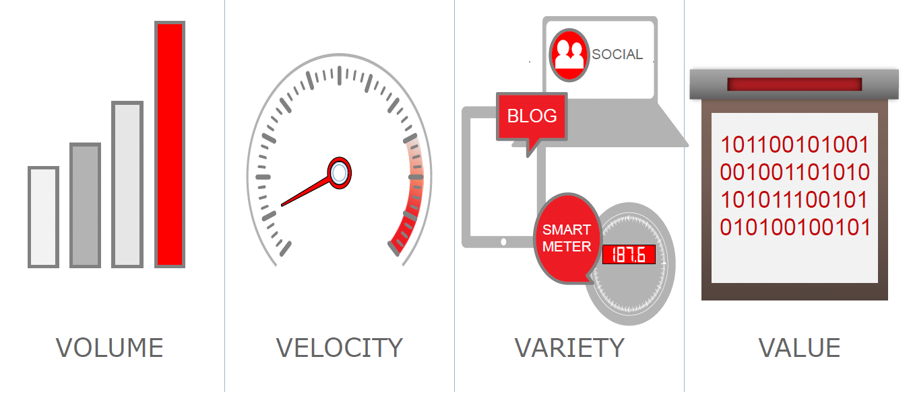
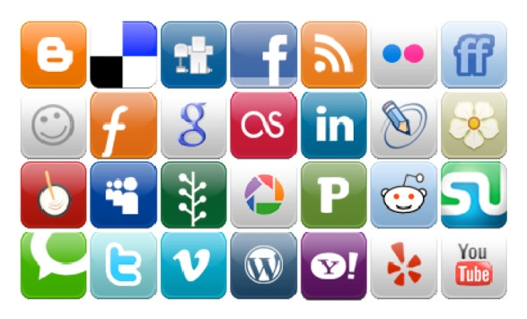
Social Networks are “Big Data”
Facebook:
Volume： 10 x 10⁸ users, 2400 x 10⁸ photos, 10⁴ x 10⁸ page visits
Velocity： 7.9 new users per second, over 60 thousands per day
Variety： text (weibo, blogs) , figures, videos, relationships (topology)
Value：1.5 x 10⁸ dollars in 2007, 3 x 10⁸ dollars in 2008, 6 ~ 7 x 10⁸ dollars in 2009, 10 x 10⁸ dollars in 2010.
Further, data are often dirty due to data missing and data uncertainty ^{[1, 2]}
Notes:
《福布斯》日前评选出十位最年轻的亿万富翁，26岁的马克-扎克伯格以69亿美元的身价排在首位，他也因此成为世界上最年轻的亿万富翁。

Slide 18


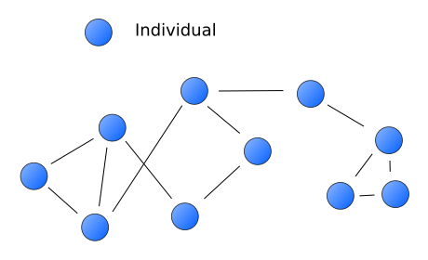
Social Networks are Big Graphs
Social networks are graphs
The nodes are the people and groups
The links/edges show relationships or flows between the nodes.

Slide 19
The Need for a Social Search Engine

Slide 20
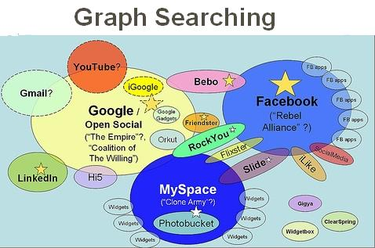


The Need for a Social Search Engine
File systems
Databases
World Wide Web
Social Networks
File systems - 1960’s： very simple search functionalities
Databases - mid 1960’s：SQL language
World Wide Web - 1990’s：keyword search engines
Social networks - late 1990’s:
Facebook launched “graph search” on 16th January, 2013
Assault on Google, Yelp, and LinkedIn with new graph search;
Yelp was down more than 7%
Graph search is a new paradigm for social computing!
Notes:
Yelp躺着中枪，股价大跌7%；

Slide 21
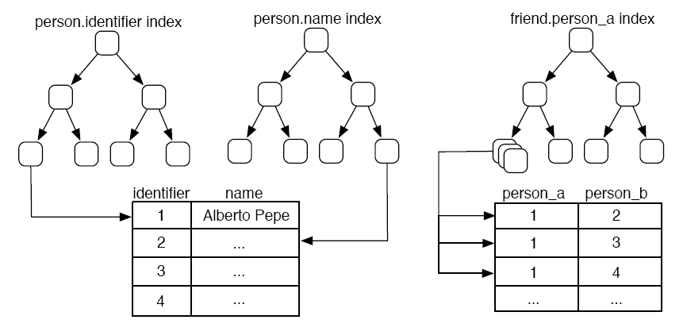
Graph Search vs. RDBMS^{[3]}
Query：
Find the name of all of
Alberto Pepe's friends.
Step 1: The person.name index -> the identifier of Alberto Pepe. [O(log₂n)]
Step 2: The friend.person index -> k friend identifiers. [O(log₂x) : x<<m]
Step 3: The k friend identifiers -> k friend names. [O(k log2n)]
Notes:
1. Query the person.name index to find the row in person table with the name Alberto Pepe." [O(log2n)]
2. Given the person row returned by the index, get the identifier for that row.[O(1)]
3. Query the friend.person a index to find all the rows in friend with the identier from previous. [O(log2x) : x<<m]
4. Given each of the k rows returned, get the person b identier for those
rows. [O(k)]
5. For each k friend identiers, query the person.identifier index for the row with friend identier. [O(k log2n)]
6. Given the k person rows, get the name value for those rows. [O(k)]

Slide 22
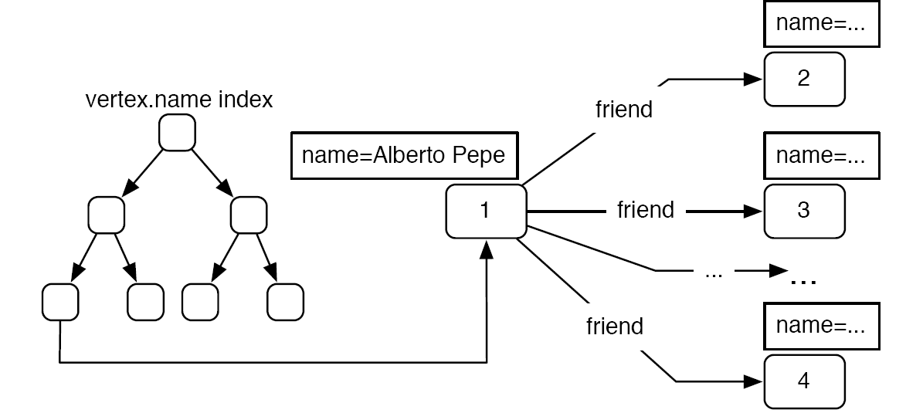
Graph Search vs. RDBMS^{[3]}
Query：
Find the name of all of
Alberto Pepe's friends.
Step 1: The vertex.name index -> the vertex with the name Alberto Pepe. [O(log2n)]
Step 2: The vertex returned -> the k friend names. [O(k + x)]
Notes:
1. Query the vertex.name index to find all the vertices in G with the name Alberto Pepe. [O(log2n)]
2. Given the vertex returned, get the k friend edges emanating from this vertex. [O(k + x)]
3. Given the k friend edges retrieved, get the k vertices on the heads of those edges. [O(k)]
4. Given these k vertices, get the k name properties of these vertices. [O(ky)]

Slide 23
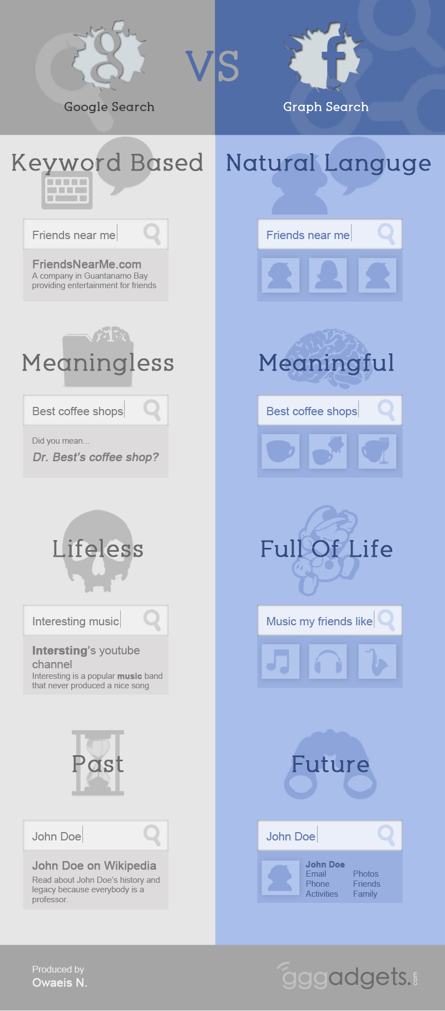
Social Search vs. Web Search
Phrases、short sentences vs. key words only
(Simple Web) pages vs. Entities
Lifeless vs. Full of life
History vs. Future
it’s interesting, and over the last 10 years, people have been trained on how to use search engines more effectively.
Keywords & Search In 2013: Interview With A. Goodman & M. Wagner
International Conference on Application of Natural Language to Information Systems (NLDB) started from 1995

Slide 24
Academia's Research Interests
Social computing
&
Web 2.0
DB people started working on graphs at around the same time！

Slide 25
Applications of Graph Search

Slide 26
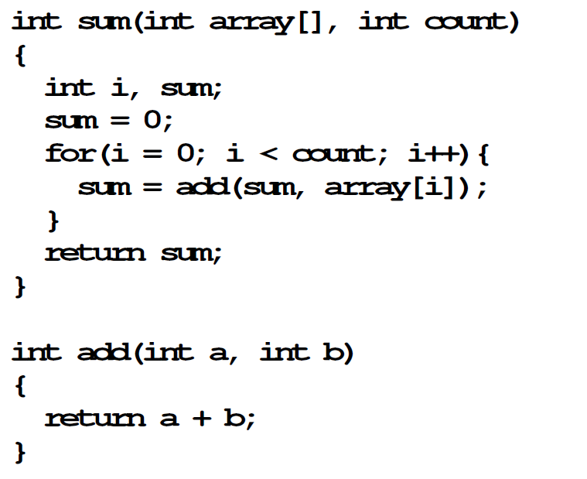
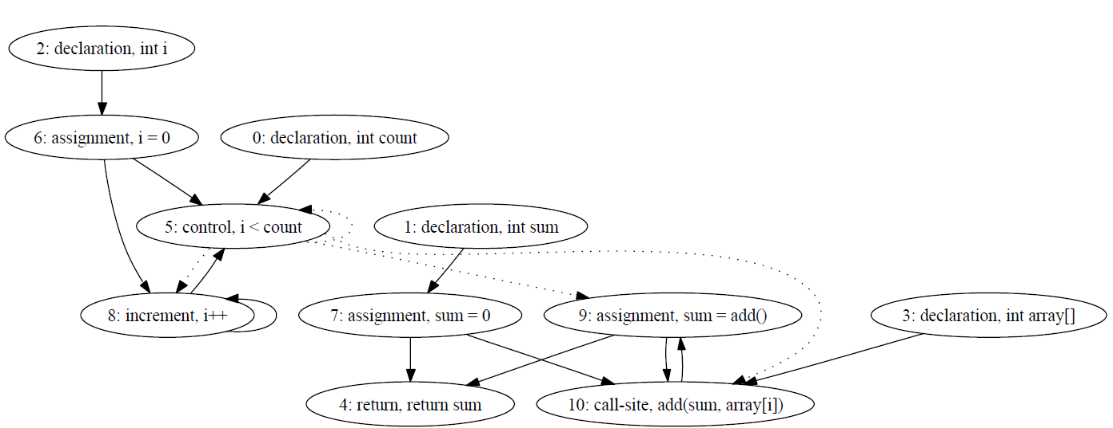
Application Scenarios
Software plagiarism detection ^{[4]}
Traditional plagiarism detection tools may not be applicable for serious software plagiarism problems.
A new tool based on graph pattern matching
Represent the source codes as program dependence graphs ^{[5]}.
Use graph pattern matching to detect plagiarism.

Slide 27
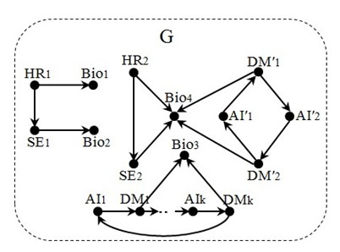
Application Scenarios
Recommender systems ^{[6]}
Recommendations have found its usage in many emerging specific applications, such as social matching systems.
Graph search is a useful tool for recommendations.
A headhunter wants to find a biologist (Bio) to help a group of software engineers (SEs) analyze genetic data.
To do this, (s)he uses an expertise recommendation network G, as depicted in G, where
a node denotes a person labeled with expertise, and
an edge indicates recommendation, e.g., HR₁ recommends Bio₁, and AI₁ recommends DM₁

Slide 28
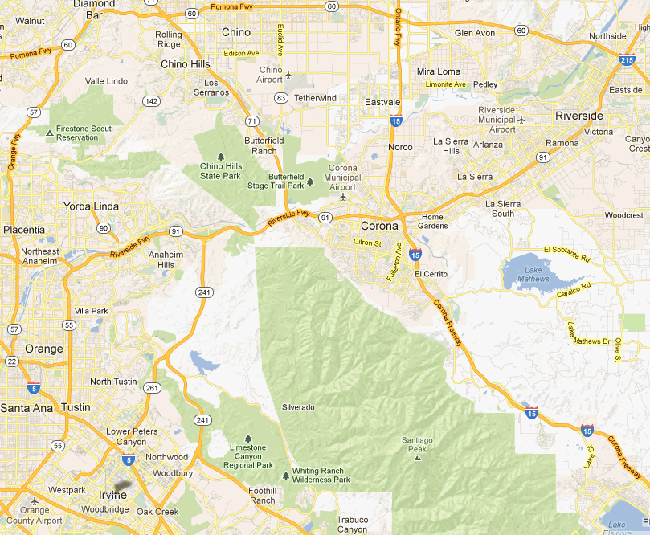
Application Scenarios
Transport routing ^{[7,10]}
Graph search is a common practice in transportation networks, due to the wide application of Location-Based Services.
Example: Mark, a driver in the U.S. who wants to go from Irvine to Riverside in California.
If Mark wants to reach Riverside by his car in the shortest time, the problem can be expressed as the shortest path problem. Then by using existing methods, we can get the shortest path from Irvine, CA to Riverside, CA traveling along State Route 261.
If Mark drives a truck delivering hazardous materials may not be allowed to cross over some bridges or railroad crossings. This time we can use a pattern graph containing specific route constraints (such as regular expressions) to find the optimal transport routes.
Notes:
Mark, a driver in the U.S. who wants to go from Irvine to Riverside in California .
Then the task is to choose the correct route, and whether the route is convenient depends on the requirements and constraints of Mark.

Slide 29
Challenges & Related Techniques

Slide 30
Challenges
The amount of data has reached hundred millions orders of magnitude.
The data are updated all the time, and the updated amount of data daily reaches hundred thousands orders of magnitude.
Same with traditional relational data, there exists data quality problems such as data uncertainty and data missing in the new applications.
Graph search with high efficiency, striking a balance between its performance and accuracy.
Consider the dynamic changes and timing characteristics of data.
Solve the data quality problems.

Slide 31
Distributed Processing
Real-life graphs are typically way too large:
Yahoo! web graph: 14 billion nodes
Facebook: over 0.8 billion users
Real-life graphs are naturally distributed:
Google, Yahoo! and Facebook have large-scale data centers
It is NOT practical to handle large graphs on single machines
Distributed graph processing is inevitable
It is nature to study “distributed graph search”!

Slide 32
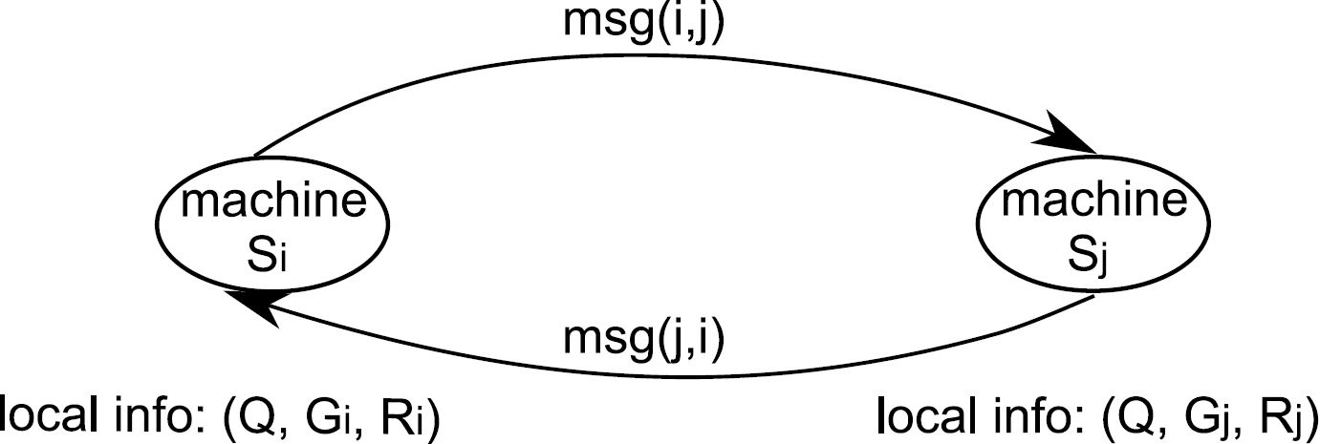
Distributed Processing
Model of Computation ^{[3]}:
A cluster of identical machines (with one acted as coordinator);
Each machine can directly send arbitrary number of messages to another one;
All machines co-work with each other by local computations and message-passing.
Complexity measures:
1. Visit times: the maximum visiting times of a machine (interactions)
2. Makespan: the evaluation completion time (efficiency)
3. Data shipment: the size of the total messages shipped among distinct
machines (network band consumption)
32

Slide 33
Incremental Techniques
Google Percolator ^{[9]}:
Converting the indexing system to an incremental system,
Reduce the average document processing latency by a factor of 100
Process the same number of documents per day, while reducing the average age of documents in Google search results by 50%.
It is a great waste to compute everything from scratch!

Slide 34
Data Preprocessing
Data Sampling
Instead of dealing with the entire data graphs, it reduces the size of data graphs by sampling and allows a certain loss of precision.
In the sampling process, ensure that the sampling data obtained can reflect the characteristics and information of the original data graphs as much as possible.
Data Compression
It generates small graphs from original data graphs that preserve the information only relevant to queries.
A specific compression method is applied to a specific query application, such that data graph compression is not universal for all query applications.
Reachability query, Neighbor query

Slide 35
Data Preprocessing
Indexing
There are mainly three standards for measuring the goodness of an indexing method.
The space of a graph index
Establishing time for a graph index
Query time with a graph index
Data Partitioning
Partition a data graph to relatively “small” graphs
Hash function is a simple approach for random partitioning.
There are well established tools, e.g., Metis [11].

Slide 36
Related Publications
[1] Shuai Ma, Yang Cao, Wenfei Fan, Jinpeng Huai, and Tianyu Wo, Strong Simulation: Capturing Topology in Graph Pattern Matching. ACM TODS, 2014, to appear.
[2] Weiren Yu, Charu Aggarwal, Shuai Ma*, and Haixun Wang, On Anomalous Hot Spot Discovery in Graph Streams, ICDM 2013.
[3] Shuai Ma, Yang Cao, Jinpeng Huai, and Tianyu Wo, Distributed Graph Pattern Matching, WWW 2012.
[4] Shuai Ma, Yang Cao, Wenfei Fan, Jinpeng Huai, and Tianyu Wo, Capturing Topology in Graph Pattern Matching, VLDB 2012.
[5] Wenfei Fan, Jianzhong Li, Shuai Ma*, Nan Tang, and Yinghui Wu, Adding Regular Expressions to Graph Reachability and Pattern Queries, ICDE 2011.
[6] Wenfei Fan, Jianzhong Li, Shuai Ma, Nan Tang, Yinghui Wu, and Yunpeng Wu, Graph Pattern Matching: From Intractable to Polynomial Time, VLDB 2010.
[7] Wenfei Fan, Jianzhong Li, Shuai Ma, Hongzhi Wang, and Yinghui Wu, Graph Homomorphism Revisited for Graph Matching, VLDB 2010.
[8] Wenfei Fan, Jianzhong Li, Shuai Ma*, Nan Tang, and Yinghui Wu, Adding Regular Expressions to Graph Reachability and Pattern Queries. FCS, Volume 6, Number 3, 313-338, 2012 (Invited).
[9] Shuai Ma, Jia Li, Xudong Liu, and Jinpeng Huai, 大数据时代的图搜索技术, 《信息通信技术》,第6期, 41-55, 2013. (Invited).
[10] Shuai Ma, Yang Cao,Tianyu Wo, and Jinpeng Huai, 社会网络与图匹配查询,《中国计算机学会通讯》第8卷第4期20-24, 2012. (Invited).
[11] Shuai Ma, Jianxin Li, and Chunming Hu, 大数据科学与工程的挑战与思考, 《中国计算机学会通讯》第8卷第9期, 22-28, 2012. (Invited).
[12] Shuai Ma, Jia Li, Xudong Liu, and Jinpeng Huai, 图查询：社会计算时代的新型搜索,《中国计算机学会通讯》第8卷第11期, 26-31, 2012. (Invited).

Slide 37
References
[1] Eytan Adar and Christopher Re, Managing Uncertainty in Social Networks, IEEE Data Eng. Bull., pp.15-22, 30(2), 2007.
[2] Gueorgi Kossinets, Effects of missing data in social networks. Social Networks 28:247-268, 2006.
[3] Marko A. Rodriguez, Peter Neubauer: The Graph Traversal Pattern. Graph Data Management 2011: 29-46.
[4] Chao Liu, Chen Chen, Jiawei Han and Philip S. Yu, GPLAG: detection of software plagiarism by program dependence graph analysis. KDD 2006.
[5] J. Ferrante, K. J. Ottenstein, and J. D. Warren. The program dependence graph and its use in optimization. ACM Trans. Program. Lang. Syst., 9(3):319–349, 1987.
[6] Shuai Ma, Yang Cao, Jinpeng Huai, and Tianyu Wo, Distributed Graph Pattern Matching, WWW 2012.
[7] Rice, M. and Tsotras, V.J., Graph indexing of road networks for shortest path queries with label restrictions,VLDB 2010.
[8] David A. Bader and Kamesh Madduri, A graph-theoretic analysis of the human protein-interaction network using multicore parallel algorithms. Parallel Computing 2008.
[9] Daniel Peng, Frank Dabek: Large-scale Incremental Processing Using Distributed Transactions and Notifications. OSDI 2010.
[10] C. C. Aggarwal and H. Wang. Managing and Mining Graph Data. Springer, 2010.
[11] Metis. http://glaros.dtc.umn.edu/gkhome/views/metis.

Slide 38
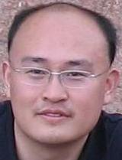
Brief Bio
Dr. Shuai Ma
PhDs (Peking University 2004 and Edinburgh University 2010)
Bell Labs, USA (Summer Consultant/Intern)
Edinburgh University, UK (Post Doc)
Microsoft Research Asia (Visiting Researcher)
From 2011 Beihang University (Full Professor)
Homepage: http://mashuai.buaa.edu.cn
Email: mashuai@buaa.edu.cn
Address: Room G1122,
New Main Building,
Beihang University

Slide 39
Thanks!

